Slide 1
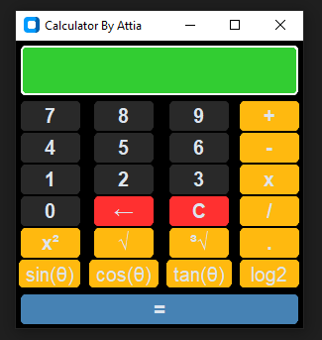
GUI CALCULATOR Using CustomTkinter in Visual Studio Code
PROJECT O1 _ NEXTHIKES INTERNSHIP PROGRAM
CREATED AND PRESENTED BY:
ATTIA ISHAQ
LIBRARY USED:
1- Custom Tkinter

Slide 2
INTRODUCTION
GUI Calculator Using CustomTkinter in Visual Studio Code
This project showcases a Graphical User Interface (GUI) Calculator developed using CustomTkinter in Visual Studio Code. The calculator is designed with a modern and user-friendly interface, with more features integrated through CustomTkinter which is an advanced Tkinter with increased style capabilities.

Slide 3
Key Features
User-Friendly Interface:
Clean Design:
Buttons are logically grouped for easy access.
Minimal Learning Curve:
Users do not have to read instructions on using the calculator.
User-centered:
It anticipates the user’s needs and, as such, is easy and plain to use.
Efficient use:
This means that calculations can be performed quickly and without confusion.

Slide 4
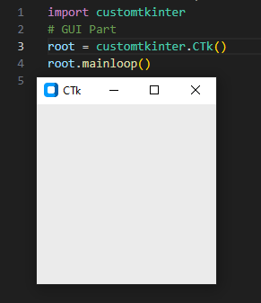
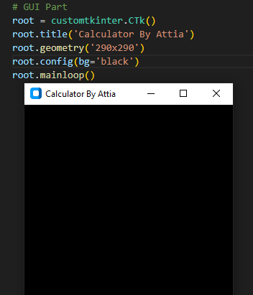
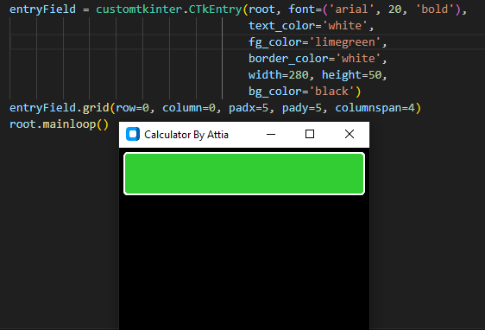
1. User-Friendly Interface
MAIN WINDOW
BACKGROUND & TITLE
ENTRY FIELD

Slide 5
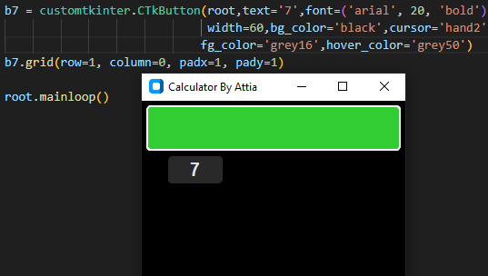
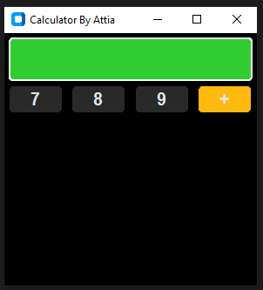
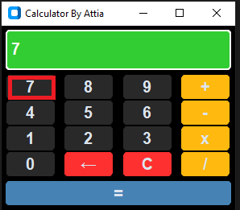
1. User-Friendly Interface
BUTTONS CREATION
GRIDING & POSITION
CLICK FUNCTION

Slide 6
Key Features
Enhanced Aesthetics:
Enhanced Styling:
It allows more flexibility with regards to design compared to a regular Tkinter.
Modern Look and Feel:
Build a professional, modern-looking interface fast and with ease.
Customizable Elements:
Easily change colors, fonts, and layouts to fit your design.
User Appeal:
This creates a professional look that appeals to users.

Slide 7
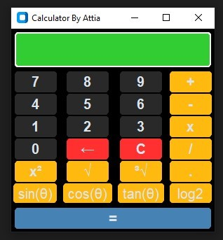
2. Enhanced Aesthetics
Modern Look and Feel
Enhanced Styling
Customizable Elements
User Appeal

Slide 8
Key Features
Core Functionality:
Basic mathematical operations like addition, subtraction, multiplication, division, exponential, square root, and cube root are easily performed.
Trigonometric and Logarithmic Functionality:
Able to perform advanced functions such as sine, cosine, tangent of an angle, and find the logarithm of a number with base 2, etc.

Slide 9
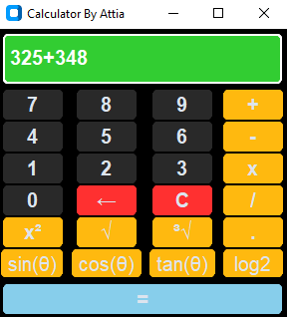
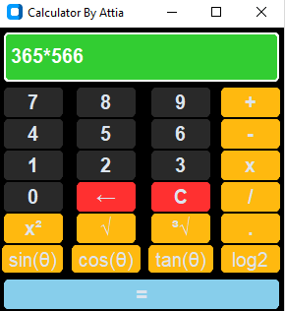
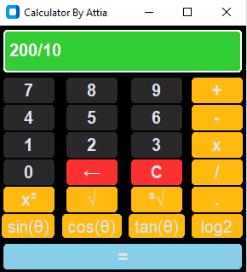
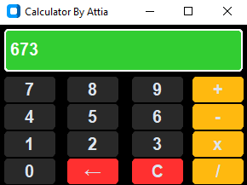
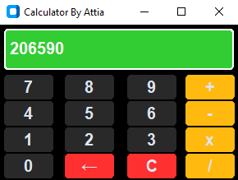
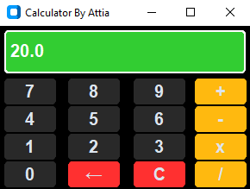
3. Core Functionality
ADDITION FUNC.
MULTIPICATION FUNC.
DIVISION FUNC.

Slide 10
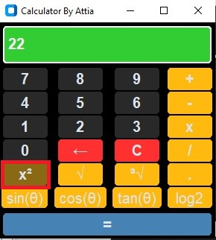
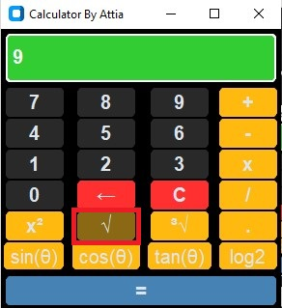
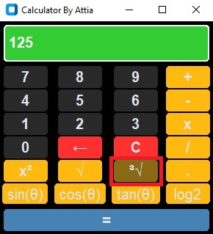
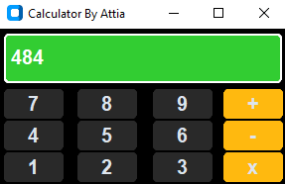
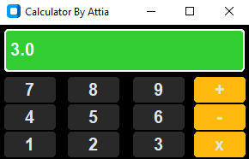
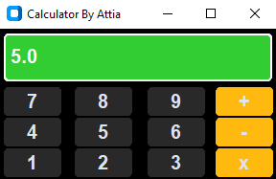
4. Trigonometric and Logarithmic Functionality
EXPONENTIAL FUNC.
SQUARE ROOT
CUBE ROOT

Slide 11
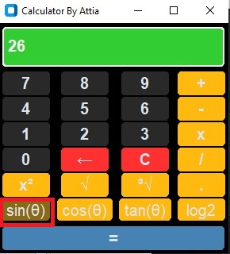
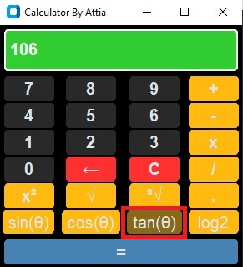
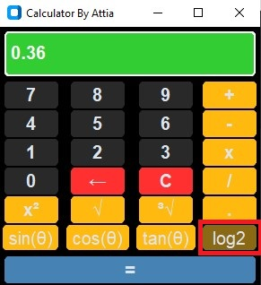
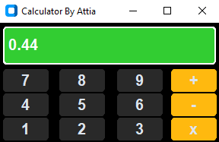
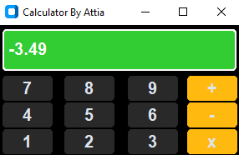
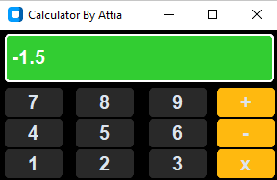
4. Trigonometric and Logarithmic Functionality
SINE FUNC.
TANGENT FUNC.
LOGARITHM B2 FUNC.

Slide 12
CONCLUSION
This GUI Calculator project showcases the effective use of CustomTkinter to create a user-friendly and visually appealing application. By integrating basic arithmetic functions with advanced trigonometric and logarithmic operations, the calculator caters to both basic and advanced user requirements. The polished design and intuitive interface guarantee ease of use, rendering it a practical tool for everyday calculations.
Key Takeaways:
Versatility:
Supports both basic and advanced mathematical functions.
Modern Design:
CustomTkinter allows for a polished and customizable interface.

